Slide 1
The Celtic
Tucker Kolon

Slide 2
What is The Celtic?
The Celtic is a website created with the purpose of hosting a database of over 465 players to ever play for the team.
Each player will have the basic player profile with picture, weight, height, position, college, experience with team, and a overall stat line with the Boston Celtics.
With this website all of your favorite Celtics will be available for your pleasure, including some of your favorites like Vander Blue who only played 3 games for the Team.
Another Feature is the game by game analysis by me. Will be going over all 82 games and playoff games.

Slide 3
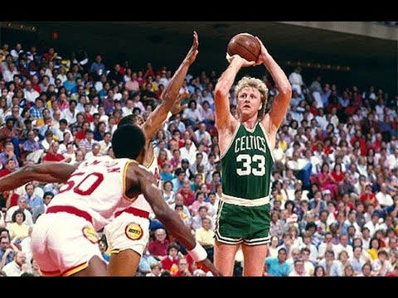

What I’m using to Code
I will be using HTML and CSS to setup the website will all the structural and design needs to make my website looked polished and functional.
For my queue I will be using MySQL to host the 465 player profiles to be able to be search up at a moment’s notice.

